Slide 1

Our RE Curriculum at Blessed Dominic

Slide 2
Agenda
The new Religious Education Directory
An overview of key learning for each year groups.
Dialogue and encounter
Catholic Social Teaching
Prayer and Liturgy
Supporting at home

Slide 3
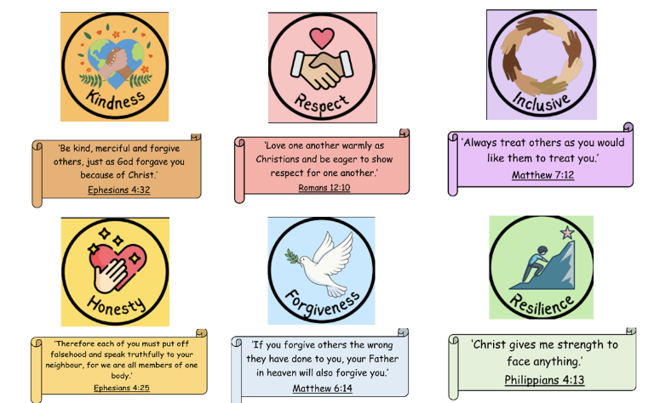
Our School Mission and Values.
Love one another. Learn together. Believe in God the Father.

Slide 4
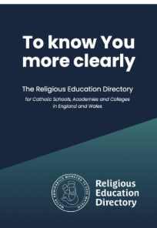
What is the new Religious Education Directory?
The Religious Education Directory (RED) is the new curriculum for Religious Education in Catholic schools across England and Wales.
Introduced in all Catholic primary schools and Secondary schools by September 2026.
The curriculum is:
Rooted in Scripture and the life of Jesus
Linked to the Church’s liturgical year
Designed to build knowledge progressively from EYFS to Year 6
Focused on helping children grow spiritually, morally and academically

Slide 5

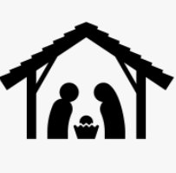
The Six Curriculum Branches
Each year group studies the same six branches, with learning becoming deeper and more challenging as children move through school.
Creation and Covenant
Prophecy and Promise

Slide 6


Spring
Galilee to Jerusalem
Desert to Garden

Slide 7


Summer
To the Ends of the Earth
Dialogue and Encounter

Slide 8
The Four Knowledge Lenses
Children learn through four key areas:
Hear – listening to Scripture
Believe – understanding Catholic beliefs
Celebrate – exploring prayer and liturgy
Live – applying faith to everyday life

Slide 9
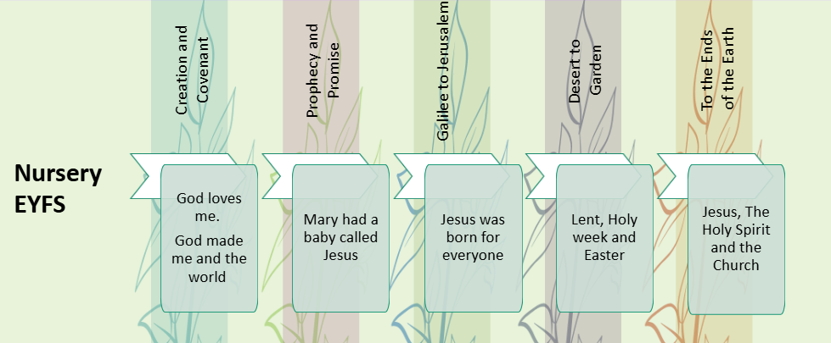
EYFS
Children begin to:
Learn that God loves every person
Hear simple Bible stories
Join in prayer, songs and celebrations
Recognise that the Church is a special community
Talk about kindness, love and caring for others

Slide 10
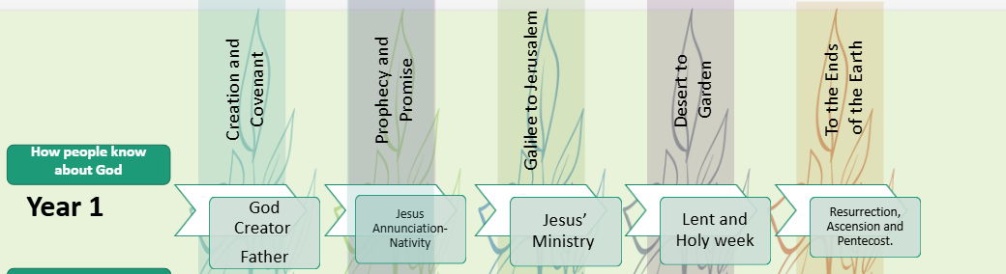
Year 1- how people know about God
Children learn:
God created the world and cares for creation
Jesus is God’s Son and teaches us how to love
The meaning of Advent and Christmas
Simple Gospel stories, such as Pentecost and the Annunciation
How Christians pray and celebrate together

Slide 11
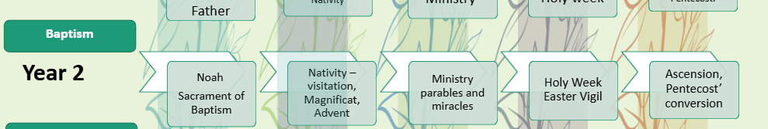
Year 2 - Baptism
Children explore:
The promises God makes with His people
The life and miracles of Jesus
Forgiveness, reconciliation and mercy
The Mass and sacraments in greater depth
Respect for people of different faiths

Slide 12
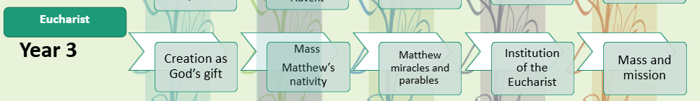
Year 3- Eucharist
Children develop understanding of:
The Bible as a collection of sacred books
Jesus’ teachings and discipleship
Lent, Holy Week and Easter in more detail
The role of the Church after Pentecost
How faith influences choices and actions

Slide 13
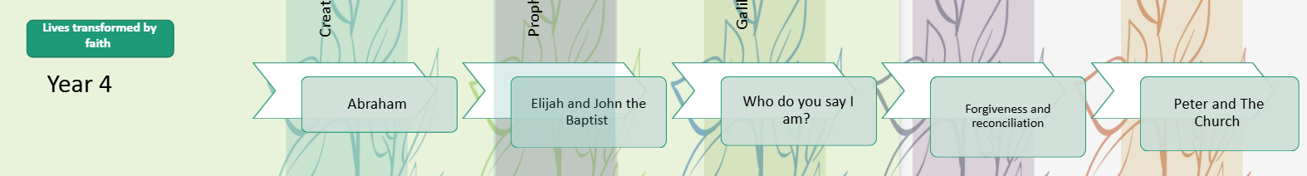
Year 4- Lives transformed by Faith
Children investigate:
The Kingdom of God in Jesus’ teaching
The connection between Scripture and Catholic tradition
Saints as examples of faith in action focusing on Saint Peter as the foundation of the Church.
Themes of forgiveness and reconciliation
Justice, compassion and Catholic Social Teaching

Slide 14
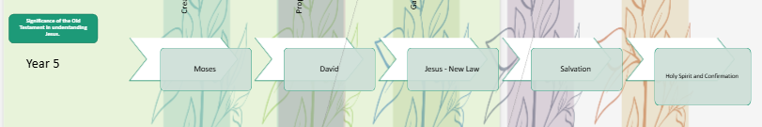
Year 5 - Significance of the Old Testament in understanding Jesus.
Children deepen knowledge of:
Covenant and salvation history
The mission of the Church in the modern world
The dignity of every human person
The meaning of sacrifice and service
Dialogue with other religions and worldviews

Slide 15
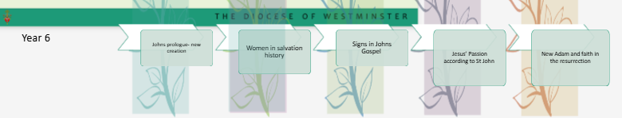
Year 6 - The Gospel of John
Children are encouraged to:
Think critically and reflect spiritually
Reflect on the lives of important women in the Bible.
Make links across Scripture and Church teaching
Explore vocation, responsibility and leadership
Consider moral and ethical questions
Understand how faith can shape society and global justice

Slide 16
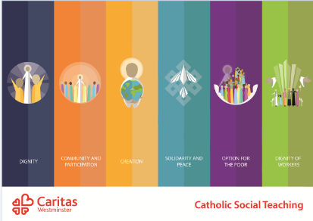
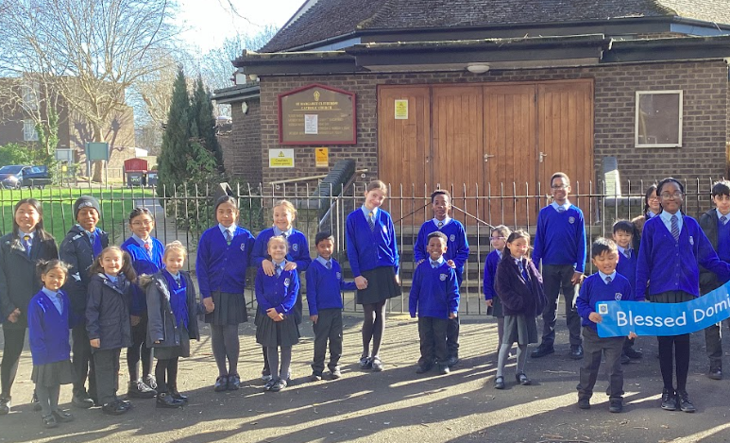
Catholic Social Teaching
Woven throughout our Curriculum are the six areas of Catholic Social Teaching.
Within these units, pupils reflect on how to live out their faith, through their actions.
“We don’t just think about our community we think about people around our whole world.”

Slide 17
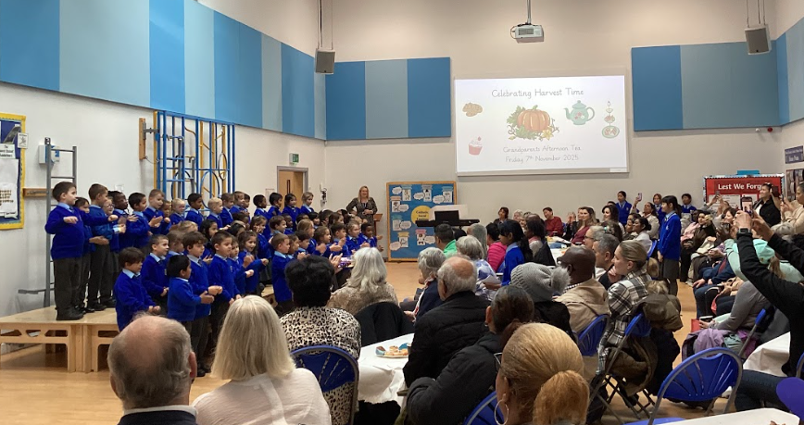
Our Catholic Curriculum
Throughout the year, pupils are actively encouraged to take part in activities that help to promote the common good and support those in our local, national and global communities. Our school works closely with charities like CAFOD, Colindale Food Bank and the Catholic Children's’ Society to help those most in need in our society.

Slide 18

Dialogue and Encounter
In Summer 2, all pupils will take part in our Dialogue and Encounter branch.
In this branch, pupils will learn how Christians work together with people of different religious beliefs work towards the common good, respecting and valuing the dignity of all humanity.
We also recgonise that many families within our school community will be celebrating different religious festivals throughout the year and we always aim to lmark these special events throughout the school year.

Slide 19
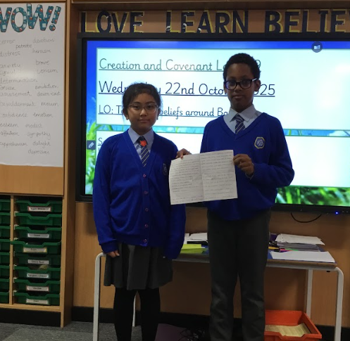
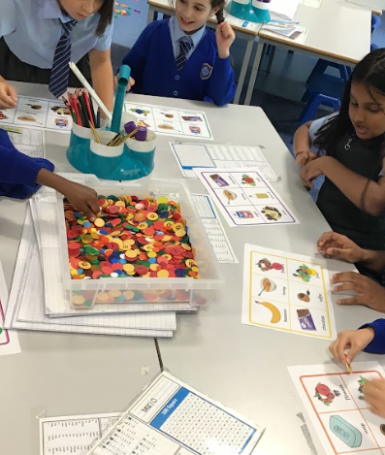
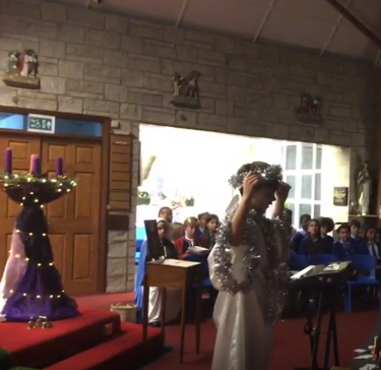
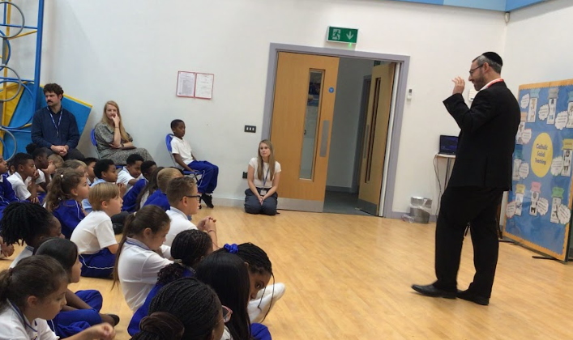
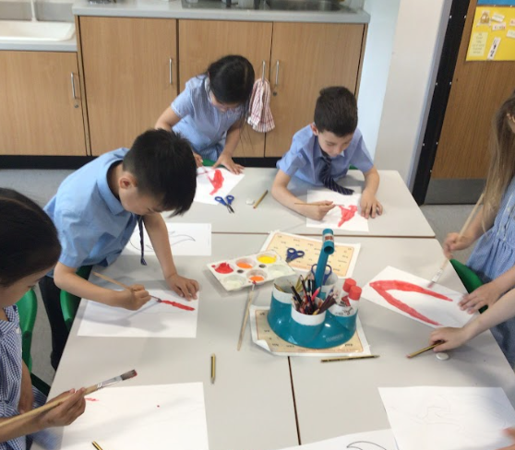
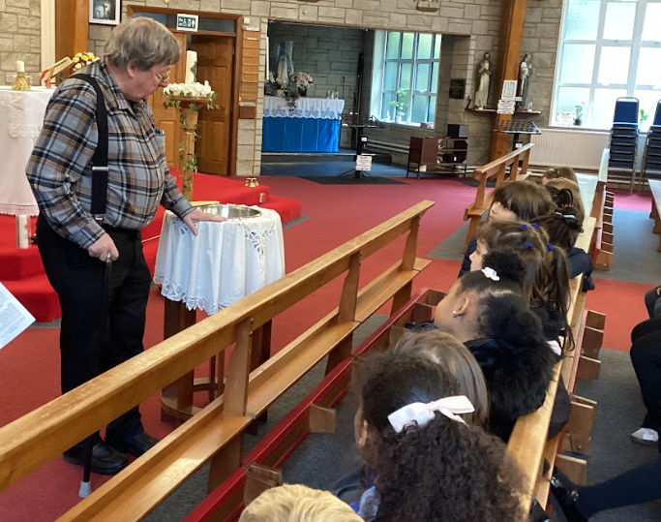
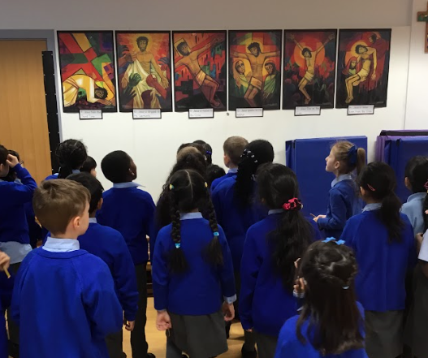
What does RE Look like at Blessed Dominic?

Slide 20
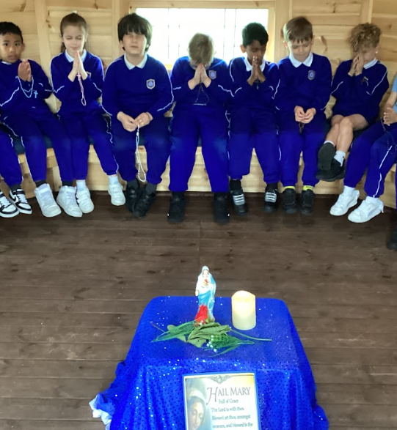
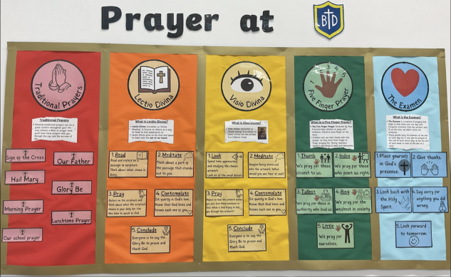
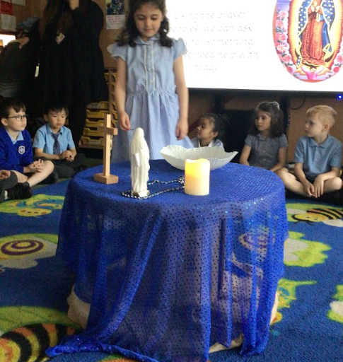
Prayer life
Prayer and worship happens daily at Blessed Dominic and is central to all we do.
Children are invited to participate in prayer in a way that feels comfortable to them and supports their own spiritual journey.

Slide 21
Supporting your child
Parents play a vital role by:
Talking about learning at home and supporting with RE homework tasks
Sharing family traditions and celebrations as well as traditions from other faiths and cultures across the world.
Encouraging prayer, reflection and quiet time.
Supporting children in living out our school values .

